Slide 1
Digital Image Processing
Lecture 3: Basic relationships between pixels
Intensity Transformations & Spatial Filtering
Dr. Hossam Mahmoud Moftah
Assistant professor – Faculty of computers and information –
Beni Suef University

Slide 2
Basic relationships between pixels
Neighbors – Adjacency
Connectivity
Regions
Boundaries

Slide 3
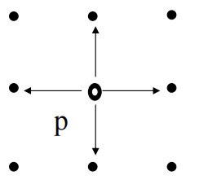
Neighbors of a pixel- The 4-neighbors of P - N₄(P)
Any pixel p(x, y) has two vertical and two horizontal neighbors, given by (x+1, y), (x-1, y), (x, y+1), (x, y-1)
This set of pixels are called the 4-neighbors of P, and is denoted by N₄(P)
Each of them are at a unit distance from P
 | (x, y-1)
(x-1, y) | P (x,y) | (x+1, y)
 | (x, y+1)

Slide 4
Neighbors of a pixel- The D-neighbors of P - N_{D}(P)
The four diagonal neighbors of p(x,y) are given by, (x+1, y+1), (x+1, y-1), (x-1, y+1), (x-1 ,y-1)
This set is denoted by N_{D}(P)
Each of them are at Euclidean distance of 1.414 from P
(x-1, y+1) |  | (x+1, y-1)
 | P (x,y)
(x-1, y-1) |  | (x+1, y+1)

Slide 5
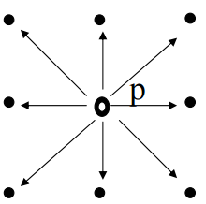
Neighbors of a pixel- The 8-neighbors of P - N₈(P)
The points N_{D}(P) and N₄(P) are together known as 8-neighbors of the point P, denoted by N₈(P)
Some of the points in the N₄, N_{D} and N₈ may fall outside image when P lies on the border of image
(x-1, y+1) | (x, y-1) | (x+1, y-1)
(x-1, y) | P (x,y) | (x+1, y)
(x-1, y-1) | (x, y+1) | (x+1, y+1)

Slide 6
Adjacency and Connectivity
Two pixels are connected if they are neighbors and their gray levels satisfy some specified criterion of similarity
For example, in a binary image two pixels are connected if they are 4-neighbors and have same value (0/1)

Slide 7
Types of Adjacency
Let V be the set of gray-level values used to define connectivity;
  4-adjacency: Two pixels p and q with values from V are 4-adjacent if q is in the set N₄(p).
  8-adjacency: Two pixels p and q with values from V are 8-adjacent if q is in the set N₈(p).
  m-adjacency =(mixed)

Slide 8
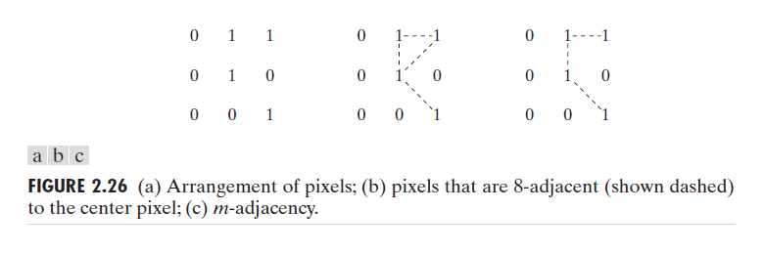
Types of Adjacency
Mixed adjacency is a modification of 8-adjacency. It is introduced to eliminate the ambiguities that often arise when 8-adjacency is used.
For example:

Slide 9
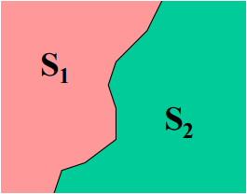
Adjacency/Connectivity
Pixel p is adjacent to pixel q if they are connected.
Two image subsets S1 and S2 are adjacent if some pixel in S1 is adjacent to some pixel in S2

Slide 10
Paths & Path lengths
A path from pixel p with coordinates (x, y) to pixel q with coordinates (s, t) is a sequence of distinct pixels with coordinates:
(x₀, y₀), (x₁, y₁), (x₂, y₂) … (x_{n}, y_{n}),
where (x₀, y₀)=(x, y) and (x_{n}, y_{n})=(s, t);
(x_{i}, y_{i}) is adjacent to (x_{i-1}, y_{i-1})
Here n is the length of the path
We can define 4-, 8-, and m-paths based on type of adjacency used.

Slide 11
Paths & Path lengths
Return to the previous example:
In figure (b) the paths between the top right and bottom right pixels are 8-paths. And the path between the same 2 pixels in figure (c) is m-path

Slide 12
Connectivity
If p and q are pixels of an image subset S then p is connected to q in S if there is a path from p to q consisting entirely of pixels in S.
• For every pixel p in S, the set of pixels in S that are connected to p is called a connected component of S.
If S has only one connected component then S is called Connected Set.

Slide 13
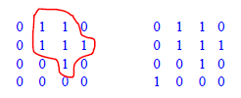
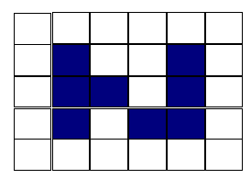


Region and Boundary
Region
  Let R be a subset of pixels in an image, we call R a region of the image if R is a connected set.

Slide 14
Region and Boundary
Boundary
The boundary (also called border or contour) of a region R is the set of pixels in the region that have one or more neighbors that are not in R.

Slide 15
Distance Measures
The Euclidean Distance between p and q is defined as:
D_{e} (p,q) = [(x – s)² + (y - t)²]^{1/2}
q (s,t)
D_{e} (p,q)
p (x,y)

Slide 16
Distance Measures
The D₄ distance (also called city-block distance) between p and q is defined as:
D₄ (p,q) = | x – s | + | y – t |
q (s,t)
D₄
p (x,y)

Slide 17
Distance Measures
The D₈ distance (also called chessboard distance) between p and q is defined as:
D₈ (p,q) = max(| x – s |,| y – t |)
q (s,t)
D_{8(b)}
p (x,y)
D_{8(a)}
D₈ = max(D_{8(a) ,} D_{8(b)})

Slide 18
Image Enhancement
Enhancement
Techniques
Spatial
Operates on pixels
Frequency Domain
Operates on FT of
Image

Slide 19
Spatial Domain Methods
In these methods a operation is performed on the pixels in the neighborhood of coordinate (x,y) in the input image F, giving enhanced image F’
Neighborhood can be any shape but generally it is rectangular ( 3x3, 5x5, 9x9 etc)
g(x,y) = T[f(x,y)]

Slide 20
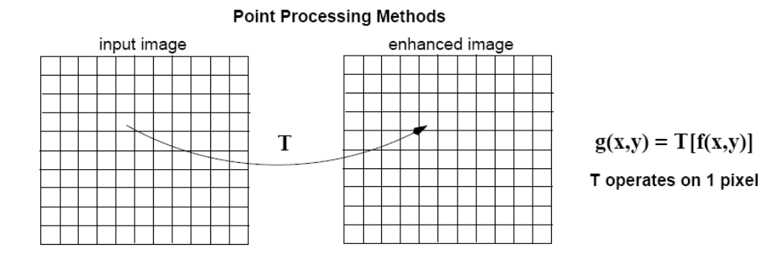
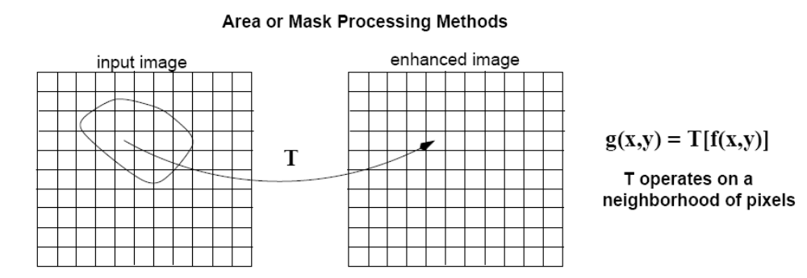
Spatial Domain Methods
f(x,y)
g(x,y)
Point
Processing
f(x,y)
g(x,y)
Area/Mask
Processing

Slide 21
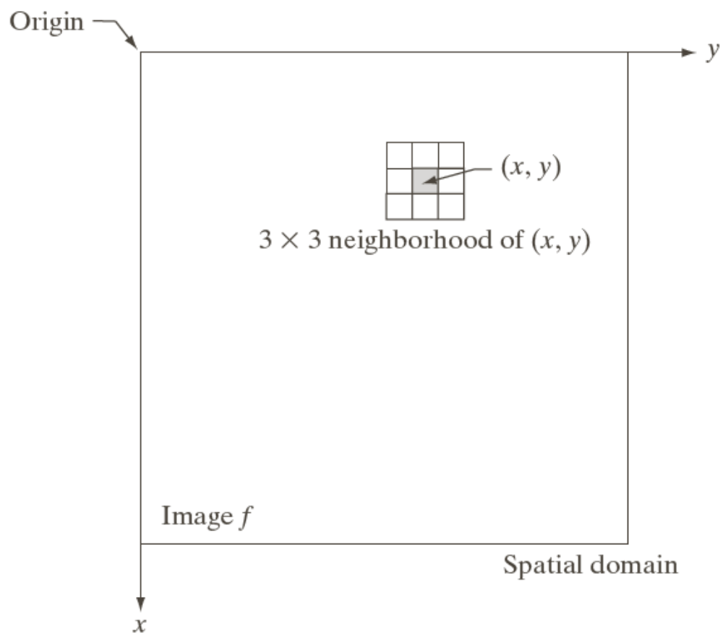
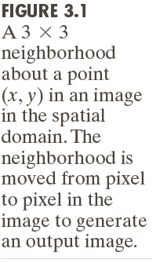
Intensity Transformations & Spatial Filtering

Slide 22
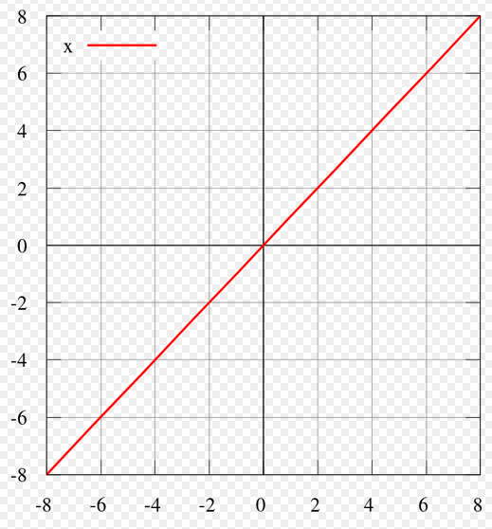
Some Basic Gray Level Transformations:
1-Identity Transformations
(Lab Assignment using python)
The identity transformation is a data transformation that copies the source data into the destination data without change.

Slide 23

2-Negative Transformations
(Lab Assignment using python)
The second linear transformation is negative transformation, which is invert of identity transformation.
In negative transformation, each value of the input image is subtracted from the L-1 and mapped onto the output image.
Example: O(r,c) = 255-I(r,c)

Slide 24
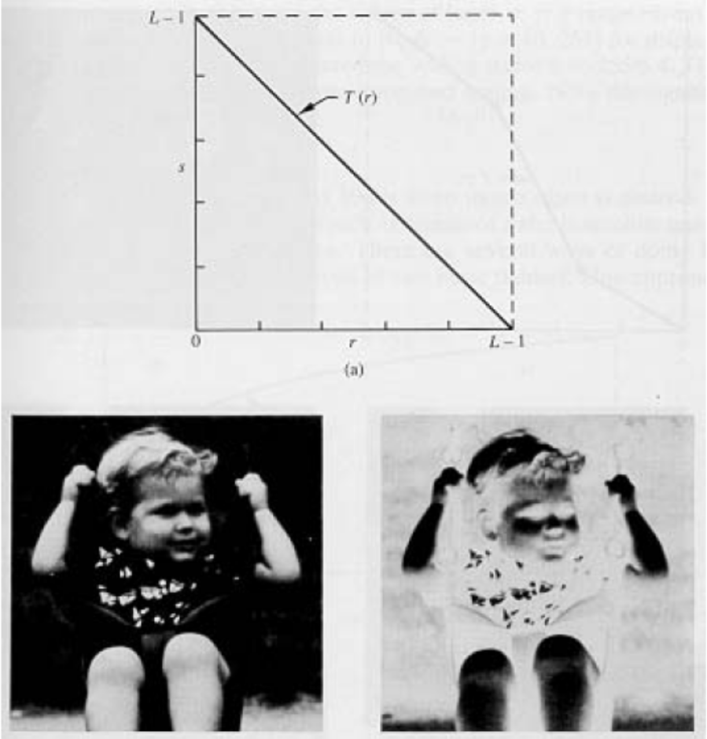
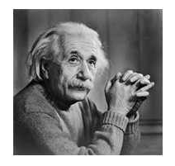
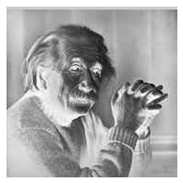
2-Negative Transformations
(Lab Assignment using python)

Slide 25

3- Log Transformations
(Lab Assignment using python)
The log transformations can be defined by this formula.
Where s and r are the pixel values of the output and the input image and c is a constant.
The value 1 is added to each of the pixel value of the input image because if there is a pixel intensity of 0 in the image, then log (0) is equal to infinity. So 1 is added , to make the minimum value at least 1.
The higher pixel values are kind of compressed in log transformation.

Slide 26


3- Log Transformations
(Lab Assignment using python)
Enhance details in the darker regions of an image at the expense of detail in brighter regions.

Slide 27

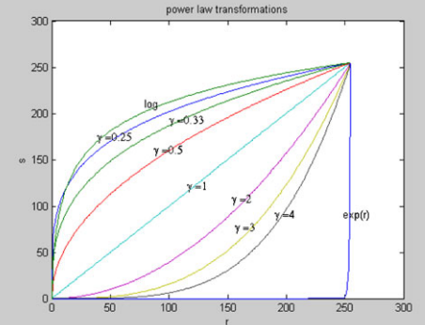
4- Power-Law Transformations
(Lab Assignment using python)
Power-Low transformations equation:
where s and r are the gray levels of the pixels in the output and the input images, respectively and c is a constant. These power law transformation functions are shown graphically in the next diagram.

Slide 28
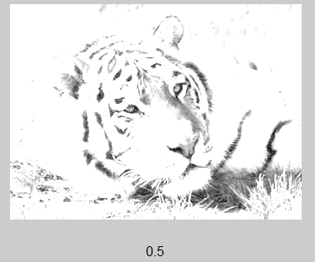
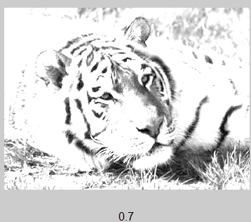
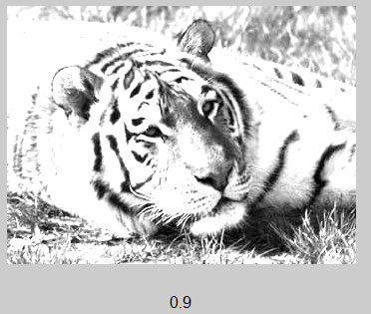
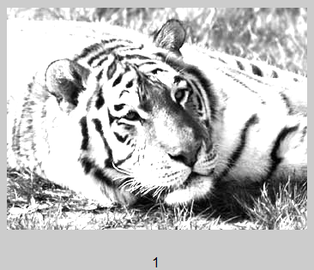
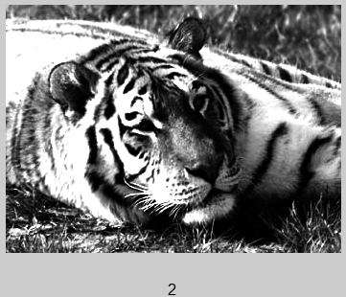
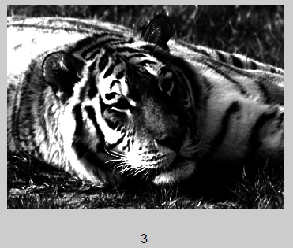
4- Power-Law Transformations (Examples)
(Lab Assignment using python)
Assume c = 2;
=[0.5 0.7 0.9 1 2 3 4 5 6];
Where : Gamma Correction Array

Slide 29
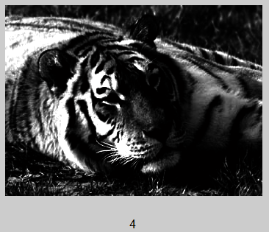
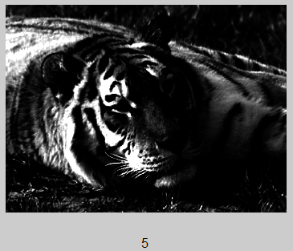
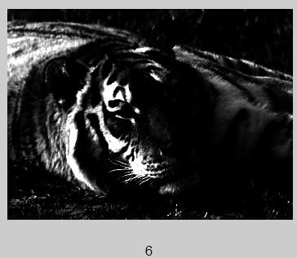
4- Power-Law Transformations (Examples)
(Lab Assignment using python)

Slide 30
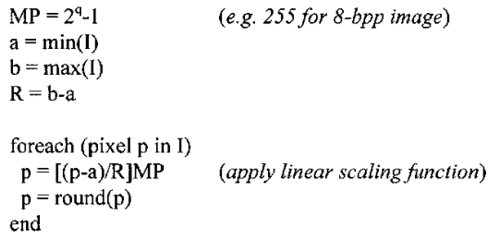
5- Contrast Stretching
(Lab Assignment using python)
Contrast stretching algorithm:

Slide 31
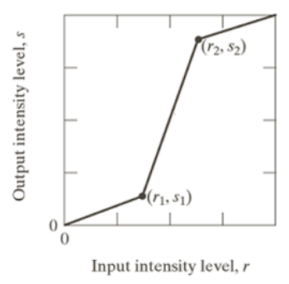
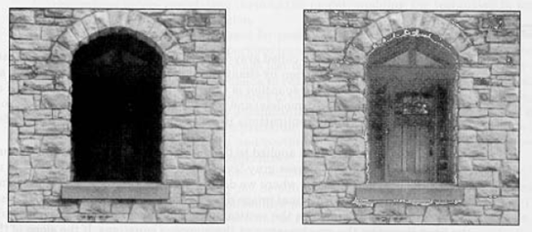
5- Contrast Stretching
(Lab Assignment using python)

Slide 32
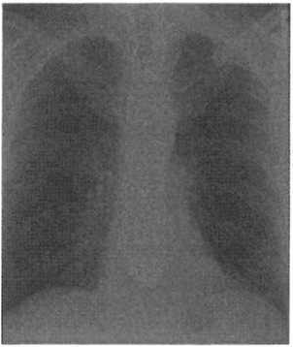
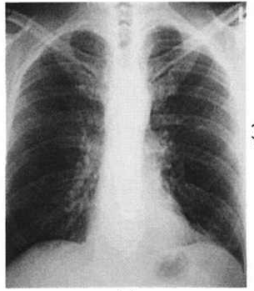
5- Contrast Stretching
(Lab Assignment using python)
X-ray image courtesy of SRS-X
Contrast-stretched chest x-ray image,

Slide 33
5- Contrast Stretching
(Lab Assignment using python)
X-ray image courtesy of SRS-X
Contrast-stretched chest x-ray image,

Slide 34

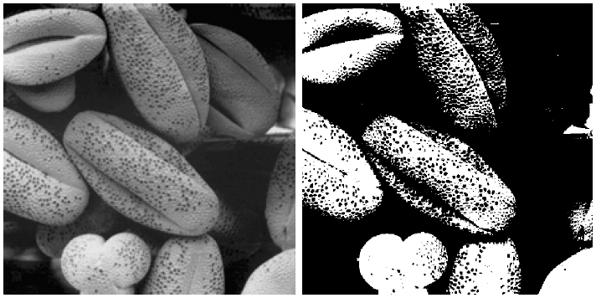
5- Contrast Stretching
(Lab Assignment using python)

Slide 35
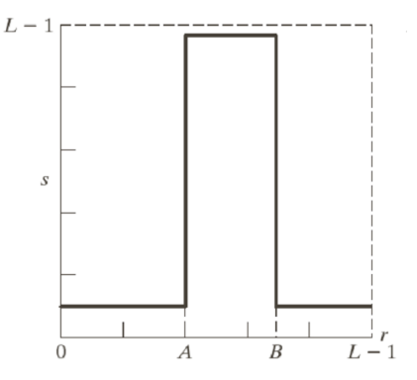
6- Intensity Slicing
(Lab Assignment using python)
One way to emphasize pixels with intensity values [A..B] is to
make these pixels white, and map intensities outside this range to black
This is very similar to intensity thresholding

Slide 36
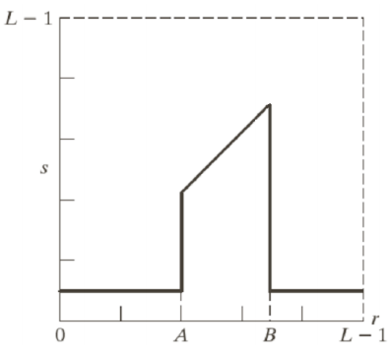
6- Intensity Slicing
(Lab Assignment using python)
Another option is to leave intensities [A..B] unchanged and map
intensities outside this range to black
This reduces the amount of ‘background clutter’ in the image

Slide 37
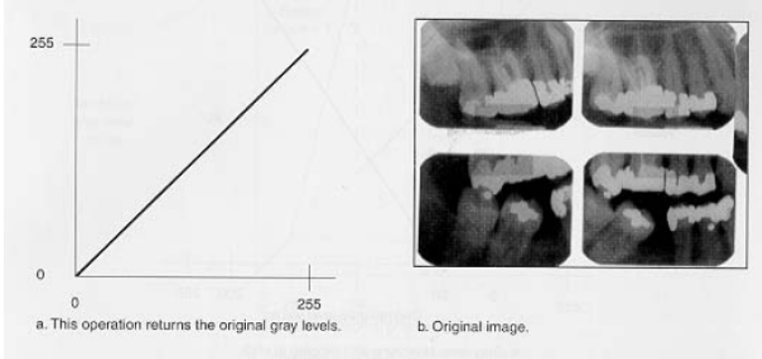
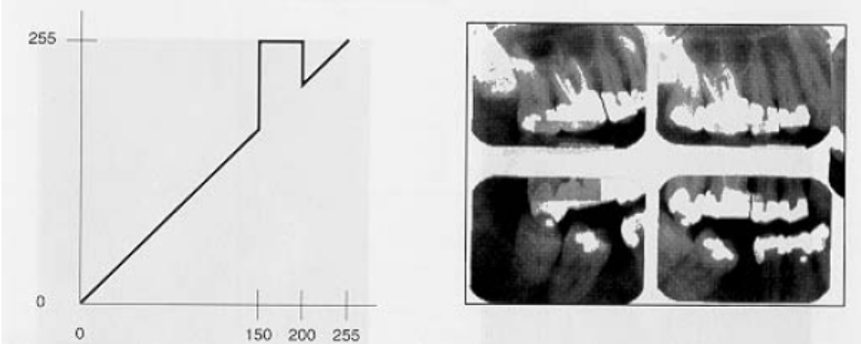
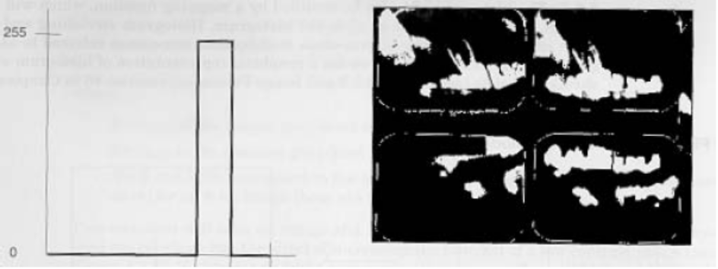
6- Intensity Slicing
(Lab Assignment using python)
Highlight specific ranges of gray-levels only.
Same as double
thresholding!

Slide 38
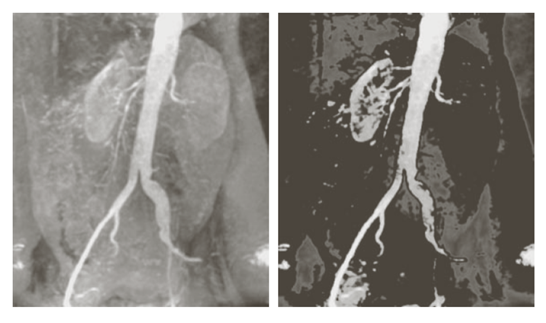
6- Intensity Slicing
(Lab Assignment using python)

Slide 39
The end

